Slide 1
The 2016 Presidential Election Campaign

Slide 2
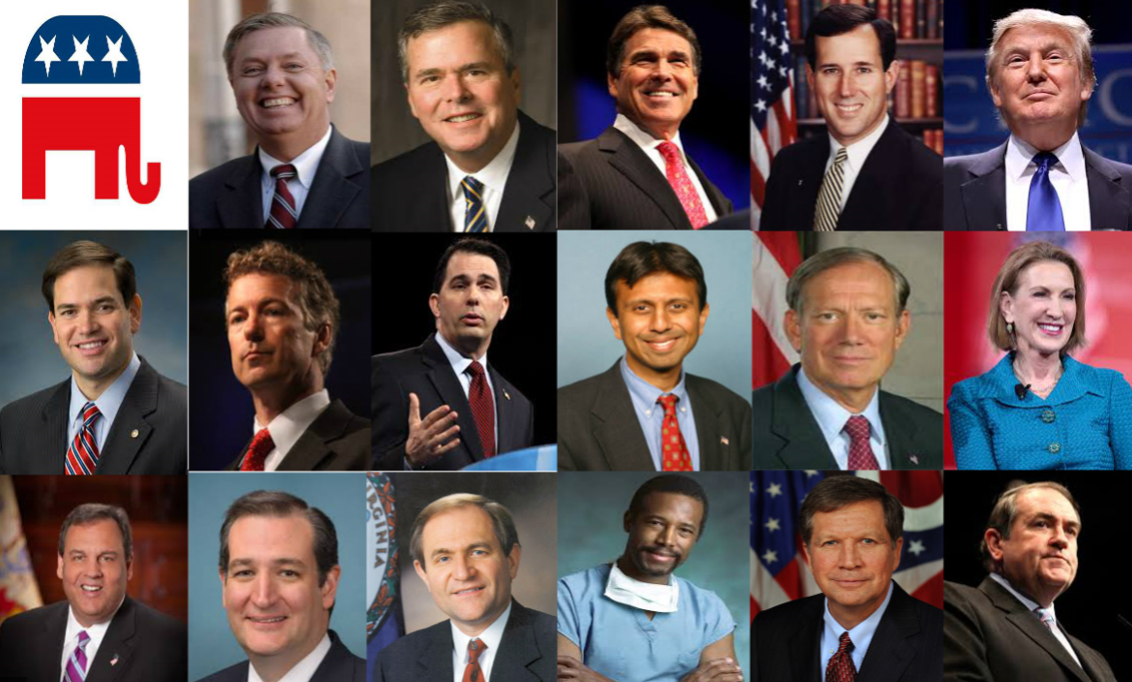
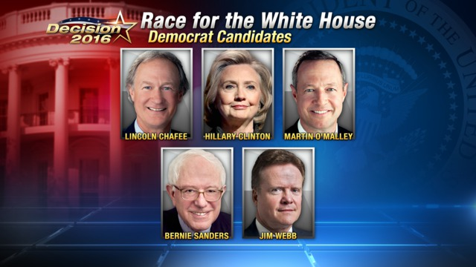
The Presidential Candidates
In 2016, in a crowded field, especially on the Republican side, Donald Trump and Hillary Clinton emerged as their respective political party’s nominee

Slide 3
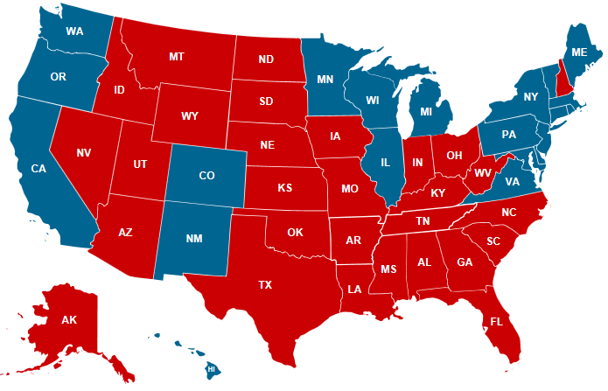
A 269-269 Tie in the Electoral College
A Tie was a Real Possibility in 2016
A tie in the Electoral College was a real possibility on Election Night (2016)
Had Hillary held on to win Pennsylvania (she lost by 1.2%) and Michigan (still too close to call), as well as 2nd congressional district in Maine (Trump won by 9%), the race would have ended in a 269-269 tie
Republican wins: OH, NC, FL, NV, NH, IA
Democrat wins: CO, WI, VA
Notes:
Red – States that the Republican nominee wins
Blue – States that the Democratic nominee wins
Had Hillary Clinton been able to hold Pennsylvania (and win Michigan and NH), then a tie would have occurred in 2016. Surprisingly, Trump won Wisconsin, but Hillary won Nevada on Election Night (2016), and if she could have won NH, then that would have been an even trade, Wisconsin being 10 electoral votes, and Nevada + NH also being 10 electoral votes. At the time of this writing (3 days after the election), Michigan and NH are still too close to call.
Winning Pennsylvania secured Trump’s victory in the Electoral College.

Slide 4
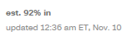
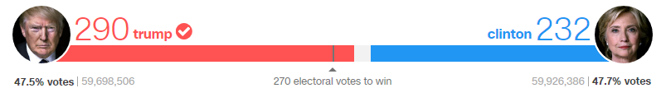
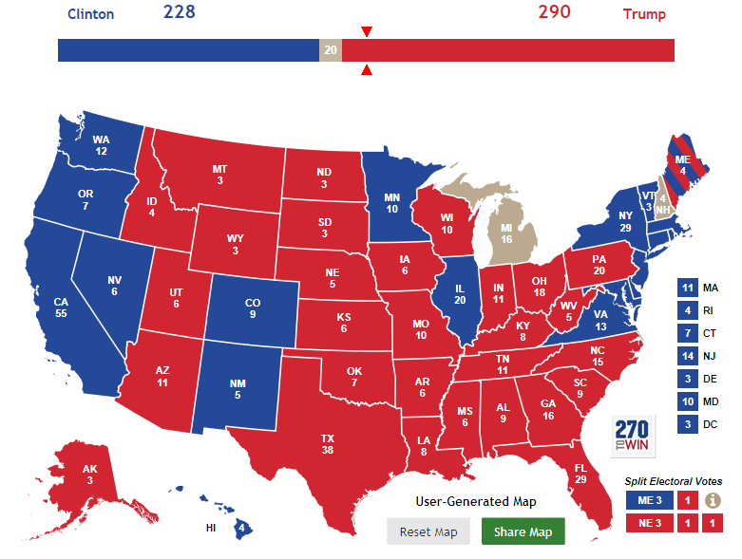
The 2016 Presidential Election The Results
270 electoral votes are needed to win a presidential election With 3 states still undecided two days after the election, Trump has won, flipping at least 4 states that Obama had won in 2012
Notes:
Source: For all pollster forecasts of the Electoral College, go to: http://www.270towin.com/2016-election-forecast-predictions/ -- none of them predicted a Trump victory
Source: http://www.cnn.com/election/results – CNN is counting NH for Hillary Clinton, who had a 0.3% lead on Election Night, but as of 11/11/2016, NH is still too close to call
Source: http://www.270towin.com/ -- at the time of this posting (11/11/2016), two states were still too close to call: Michigan and New Hampshire.
Source: http://www.cnn.com/election/2012/results/main
Trump won a number of states that Obama won in 2012: the rust-belt states (Wisconsin, Pennsylvania, Ohio), Florida, one congressional district in Maine, and possibly Michigan (another rust belt state that is still too close to call).
Here is an article by one of Trump’s harshest critics, Ezra Klein: http://www.vox.com/policy-and-politics/2016/11/9/13570824/trump-wins-election-institutions – this article captures the fear and trepidation that Trump’s opposition anticipates regarding his presidency.
2012 Presidential Election
Romney won two states in 2012 that went for Obama in 2008: Indiana and North Carolina.
But Obama won 8 of 9 battleground states: Ohio (Obama 51% Romney 48%), Wisconsin (Obama 53% Romney 46%), Virginia (Obama 51% Romney 47%), Florida (Obama 50% Romney 49%), New Hampshire (Obama 52% Romney 46%), Nevada (Obama 52% Romney 46%), Colorado (Obama 51% Romney 46%), and Iowa (Obama 52% Romney 46%). Romney won one battleground state, North Carolina (Romney 50% Obama 48%).
2008 Presidential Election
Obama was able to win 9 states that went Republican in 2004: Colorado (53% Obama 45% McCain), Florida (51% Obama 49% McCain), Indiana (50% Obama 49% McCain), Nevada (56% Obama 42% McCain), New Mexico (57% Obama 42% McCain), North Carolina (50% Obama 49% McCain), Ohio (51% Obama 48% McCain), and Virginia (52% Obama 48% McCain)
McCain did not pick up one state that went Democratic in 2004. He needed to win Pennsylvania, but he lost Pennsylvania by 11%.
2004 Presidential Election
The “Swing States” in 2004: Iowa (50% Bush 49% Kerry), Michigan (51% Kerry 49% Bush), NH (50% Kerry 49% Bush), NM (Bush 50% Kerry 49%), NV (51% Bush 48% Kerry), Ohio (51% Bush 49% Kerry), PA (51% Kerry 49% Bush), Wisconsin (50% Kerry 49% Bush)
Between 2000 and 2004, three states changed hands: New Mexico went to Gore (D) in 2000 but went to Bush (R) in 2004. New Hampshire went to Bush in 2000 but to Kerry in 2004, and Iowa went to Gore in 2000 but to Bush in 2004.

Slide 5
Presidential Elections
2016 in Perspective

Slide 6
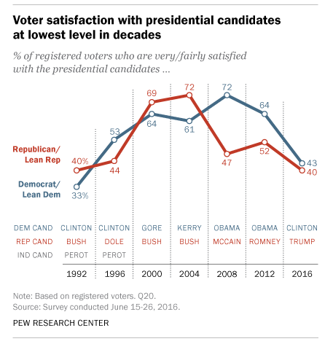
2016 Presidential Candidates
Voter Satisfaction in Perspective
In June 2016, dissatisfaction with the candidates was high, when compared with past election cycles
When voters are dissatisfied with both major candidates, turnout is usually low or 3rd party candidates receive a higher % of the vote or both
On Election Day 2016, there was a higher % of 3rd party supporters and undecideds than in past elections dating back to 2000
Notes:
See Slide#27 in this presentation for a table showing the % of 3rd party and undecideds in 2016 versus other presidential cycles from 2000 to 2012.

Slide 7
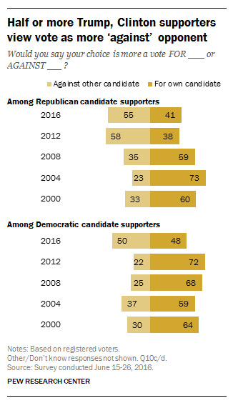
2016 Presidential Candidates
Motivation for Voting
In June 2016, the motivation to vote against one of the major candidates was unusually strong, especially among Republicans
When the motivation to vote against is strong, it is an indication that each side is dissatisfied with their own candidate, i.e., Republicans are dissatisfied with Trump, Democrats are dissatisfied with Clinton
Notes:
When there is so much negative sentiment for the two candidates, this will attract a larger 3rd party vote or lower turnout (meaning more people just chose not to vote) or both.

Slide 8
The Issues

Slide 9
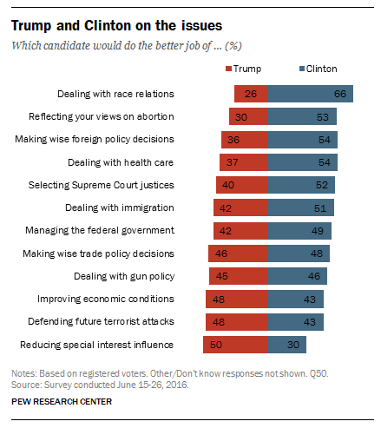
2016 Presidential Candidates
Pew Research: Issue Advantage – Issue Disadvantage
It matters which issues are relevant in a presidential election, for the list of relevant issues changes each election cycle
In 2016, the valence issues dominated the election cycle, issues that involved each candidate’s character: Is Trump too unstable in temperament to be president? Is Hillary Clinton too corrupt and dishonest to be president?
In 2016, Exit Polls suggest that the state of the economy was the top issue concern, and the Pew Research Center found that Trump had a 5% advantage on this issue

Slide 10
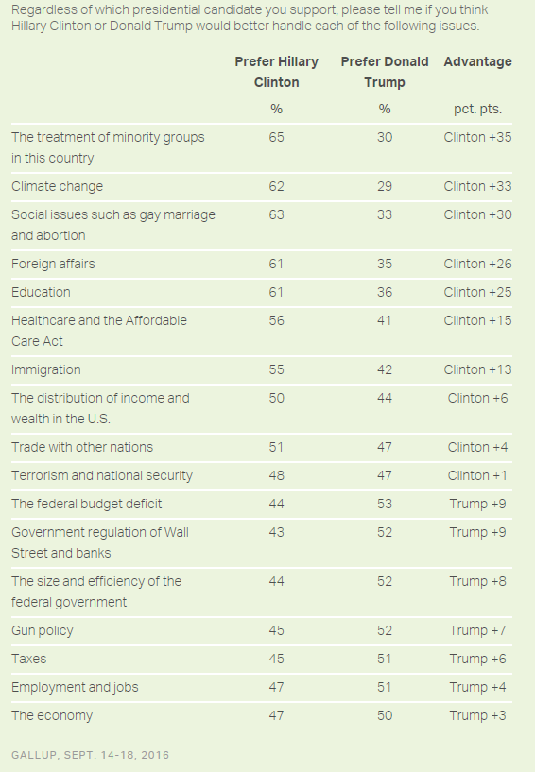
2016 Presidential Candidates
Gallup: Issue Advantage – Issue Disadvantage
Here is another look at the issues, and which candidate had an advantage with the public
As mentioned on the previous slide, the valence issues seemed to dominate the election, so in the end, many of the issues in this Gallup Poll didn’t seem to matter
But, on Election Day (2016), Exit Polls suggested that the state of the economy was the top issue concern for voters, and Gallup found that Trump had a slight 3% advantage on this issue
Notes:
http://www.gallup.com/poll/195809/voters-prefer-trump-economy-clinton-issues.aspx?g_source=Election 2016&g_medium=newsfeed&g_campaign=tiles

Slide 11
Party Divisions

Slide 12
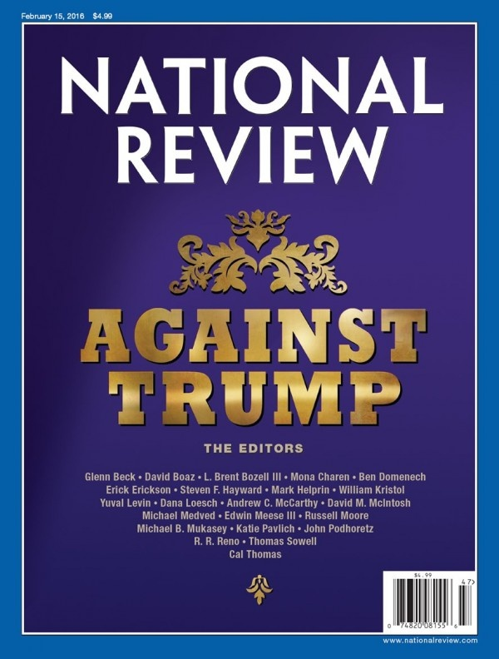
A Divided Republican Party
Conservative Ideologues Oppose Trump
The National Review is the longest running conservative publication in America. It represents the views of conservative ideologues
The editors of the National Review positioned themselves strongly against Donald Trump, because Trump has some liberal ideas and they feared he would advance the Democratic agenda as president
This created divisions within the Republican Party, which is typically bad news for the party’s nominee (Trump). A unified party is necessary to communicate a clear and positive message to independent and moderate voters, who usually make the difference in a presidential election.
Notes:
It is bad news for a political party when it is internally divided. The “message stream” (from TV, internet, newspapers, social media, etc.) is mixed, some positive and some negative. Moderates and Independents receive these messages and conclude there may be something wrong with the candidate (i.e., in this case, Trump)—thus they are more likely to vote for the other candidate (i.e., Hillary Clinton) because the message stream about the other candidate is more unified and positive, given that there is more unity in the other party.

Slide 13
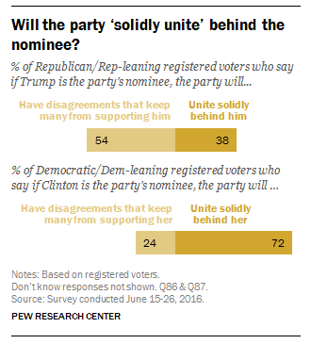
A Divided Republican Party
Public Perception
In June 2016, the perception among the public was that Trump would be much less likely to unite the Republican Party than Hillary Clinton would be to unite the Democratic Party
On Election Day (2016), Exit Polls showed that Trump won 88% of Republican voters, slightly down from the typical 90% or better, but Hillary Clinton only won 89% of Democratic voters, also down from the normal 90% or better

Slide 14
Polling Data
Which Candidate won the debates?

Slide 15
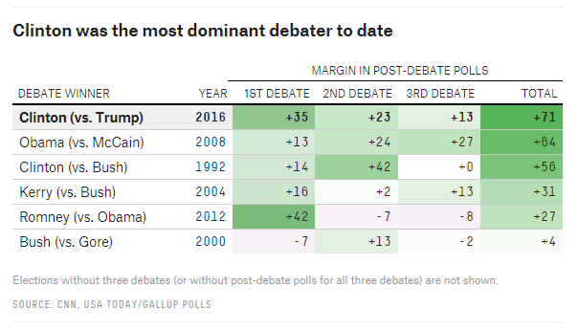
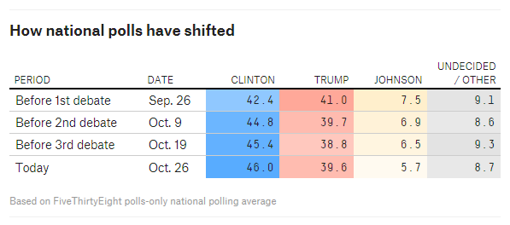
The Presidential Debates
Public Perception of the Winner
In 2016, the CNN instant polls following each debate found that the public believed that Hillary Clinton won the debates, even more decisively than the winners in past presidential campaigns
FiveThirtyEight.com found that Hillary Clinton’s polling margins over Donald Trump increased after each debate
Notes:
Source: 2016 polling date on who won the debates is provided by CNN, though this information was posted on fivethirtyeight.com -- http://fivethirtyeight.com/features/clinton-probably-finished-off-trump-last-night/
Source: Post-debate polling data -- http://fivethirtyeight.com/features/election-update-is-the-presidential-race-tightening/
In the end, Hillary Clinton’s apparent dominance in the presidential debates didn’t tip the election in her favor. In fact, the RCP 4-Way average poll showed that Hillary Clinton’s lead in the average polling fell from 7.0% to 5.8% following the 3rd debate.

Slide 16
Polling Data
Which Candidate Is Leading in the Polls?

Slide 17
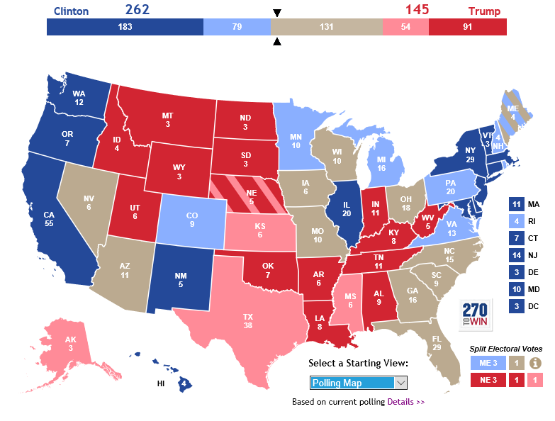
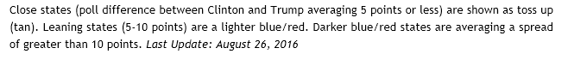
The Battleground States (September)
270towin.com: September 6 2016
According to the polls in each state, Hillary Clinton was very close to 270 electoral votes in early September (2016)
The electoral map favored Hillary Clinton with 2 months left in the campaign. Some “Republican” states were competitive: Arizona, Georgia, Missouri, South Carolina
Notes:
Source: http://www.270towin.com/
Date: Sept 6 2016

Slide 18
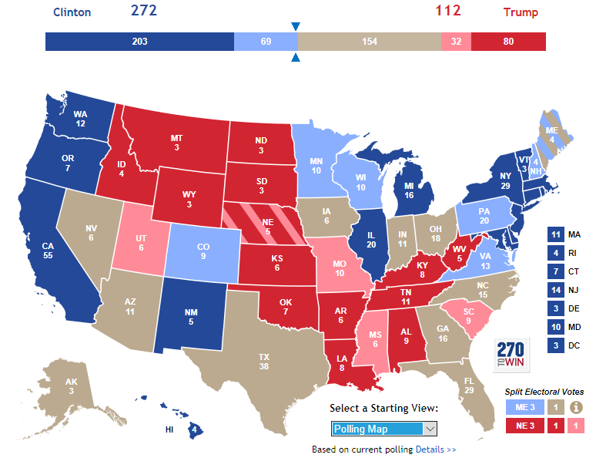
The Battleground States (October)
270towin.com: October 22 2016
According to the polls in each state, Hillary Clinton would win the 270 electoral votes necessary, if the election were held on 10/22/2016 (two weeks prior to Election Day)
Some “Republican” states were competitive in the last 2 weeks of the campaign: Alaska, Arizona, Georgia, Indiana, even Texas (Trump with only a 3% lead in Texas)
Notes:
Source: http://www.270towin.com/
Date: Oct 22 2016

Slide 19
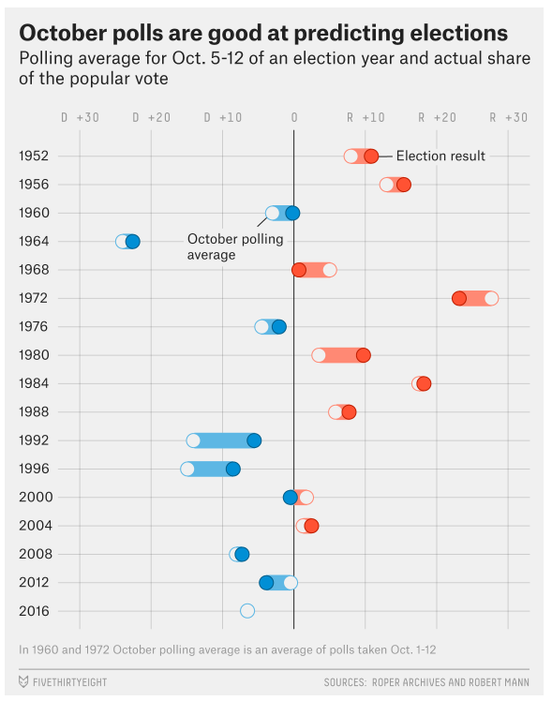
Accuracy of Presidential Polling
A Historical Look at Presidential Polling in October
Hillary Clinton led in the fivethirtyeight.com poll by about 7% in early October 2016
The analysts at fivethirtyeight.com concluded that historically, the October polls are fairly accurate in predicting the presidential winner
There were greater than 7% moves in the polls between October and Election Day in 1980 and in 1992, so based on history, it was possible, though unlikely, that Trump could reverse Hillary Clinton’s lead
By Election Day (2016), Trump was successful in closing the polling gap
Notes:
Source: Nate Silver’s fivethirtyeight.com

Slide 20
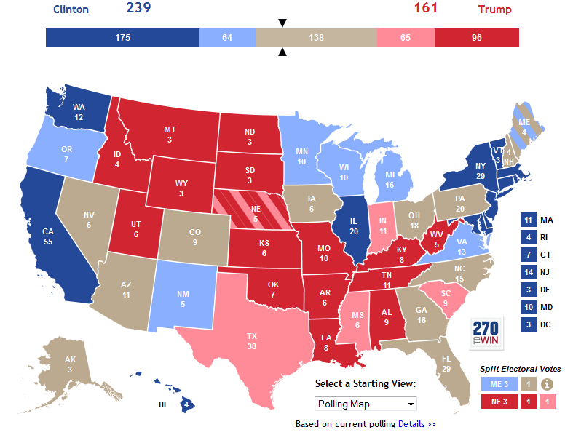
The Battleground States (November)
270towin.com: Nov 7 2016
One day prior to the election, Hillary Clinton and her surrogates were campaigning in her “firewall” states of Michigan and Pennsylvania, fearing that the “Shy Trump” voter may vote in large numbers
Still, with one day to go, the polls suggested that Trump would have to run the table of key battleground states—OH, NC, FL, NV, and NH—just to tie in the Electoral College
Notes:
Source: http://www.270towin.com/
Date: Nov 7 2016
Something changed in the last two week of the campaign. The FBI director, James Comey,

Slide 21
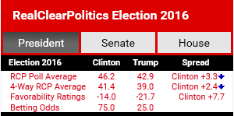
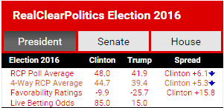
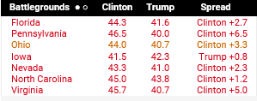
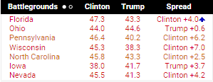
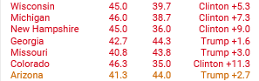
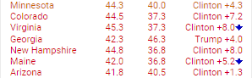
The 2016 Presidential Election An Analysis of the Polls in Battleground States (9/6/2016)
Sept 6 2016 (pre-debates)
Oct 22 2016 (post-debates)
Notes:
Source: http://realclearpolitics.com/ -- 9/6/2016, 10/22/2016
Between 9/6/2016 and 10/22/2016, the two candidates debated 3 times. More revelations about Hillary Clinton’s private-server emails emerged; hacks of Hillary Clinton’s campaign emails were released by Wikileaks; Project Veritas revealed that the Clinton campaign was (indirectly) behind the violence instigated at Trump rallies during the primaries, particularly the one in Chicago that got so much media attention. On the other side, Trump’s constant rants were reported in the media and revelations of his sexual indiscretions were also revealed, after Access Hollywood released a 2005 audio tape of Trump bragging about making sexual advances and getting away with it because of his fame, followed by 9 women coming forward claiming that Donald Trump made unwanted advances.
Debate #1 – Sept. 26th 2016
Debate #2 – Oct 9th 2016
Debate #3 – Oct 19th 2016

Slide 22
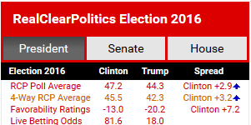
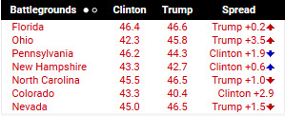
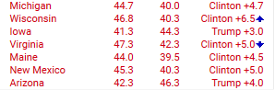
The 2016 Presidential Election An Analysis of the Polls in Battleground States (11/7/2016)
Nov 7 2016 (One Day Prior)
Notes:
Source: http://realclearpolitics.com/ -- 10/22/2016, 11/7/2016
Oct. 22nd was 3 days after the 3rd debate, and much of the commentary focused on Trump’s inability to turn the race around, with no big events, like a Reagan v. Carter like debate in the last week of the campaign. But FBI director Jim Comey dropped a bombshell with 11 days to go in the campaign, reopening the investigation of Hillary Clinton’s emails when she was Secretary of State. The polls started to change almost immediately; Hillary dropped from a steady 5.4% to 5.8% lead in the 4-way RCP average to a 1.7% lead, before starting to settle at about a lead of 2.1% to 2.2%. Then, Comey acquitted Clinton for second time, two days prior to the election. Hillary’s immediately increased to 3.2% in the 4-way RCP average, but she had lost a lot of ground in many of the battleground state polls.

Slide 23
Polling Data
Post-Election Analysis

Slide 24
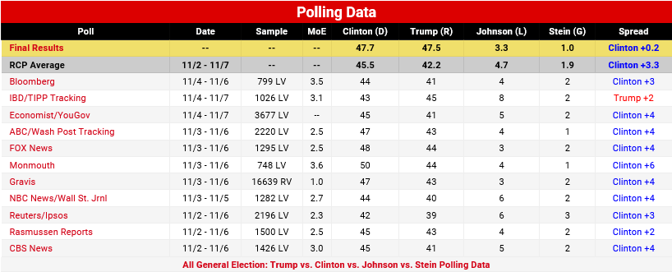
The 2016 Presidential Election Final Polls (11/8/2016)
The final polls overestimated Hillary Clinton’s popular vote totals by about 3%...as of 11/9/2016, one day after the election, Hillary was leading in the popular vote 47.7% to 47.5%, a 0.2% margin
Notes:
Source: http://www.realclearpolitics.com/epolls/2016/president/us/general_election_trump_vs_clinton_vs_johnson_vs_stein-5952.html
CNN.com: The next day after the election (10:00am, 11/9/2016), CNN had posted this tally of the nationwide vote: Trump – 47.5% (59,215,097 votes) Clinton – 47.7% (59,390,851 votes).

Slide 25
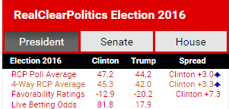
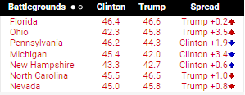
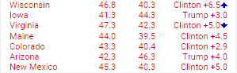
The 2016 Presidential Election Polling Errors in the Battleground States (11/8/2016)
RCP Final Poll: Nov 8 2016
Battleground State Results
Wisconsin
Trump – 47.9% Clinton – 46.9% Johnson – 3.6% Stein – 1.1%
Michigan
Trump – 47.6% Clinton – 47.3% Johnson – 3.6% Stein – 1.1%
Ohio
Trump – 52.1% Clinton – 43.5% Johnson – 3.2% Stein – 0.8%
Pennsylvania
Trump – 48.8% Clinton – 47.6% Johnson – 2.4% Stein – 0.8%
Florida
Trump – 49.1% Clinton – 47.8% Johnson – 2.2% Stein – 0.7%
North Carolina Trump – 50.5% Clinton – 46.7% Johnson – 2.8%
New Hampshire
Trump – 47.3% Clinton – 47.5% Johnson – 4.2% Nevada
Trump – 45.5% Clinton – 47.9% Johnson – 3.3%
Colorado Trump – 44.8% Clinton – 46.9% Johnson – 4.9% Stein – 1.2%
Notes:
Source: http://realclearpolitics.com/ -- 11/8/2016 (12:00am)
Source: http://www.cnn.com/election/results/president -- 11/9/2016 (3:00pm)
Here are two more battleground states in 2016:
Iowa
Trump – 51.8% Clinton – 42.2% Johnson – 3.7% Stein – 0.7%
Virginia Trump – 45.0% Clinton – 49.9% Johnson – 3.0% Stein – 0.7%

Slide 26
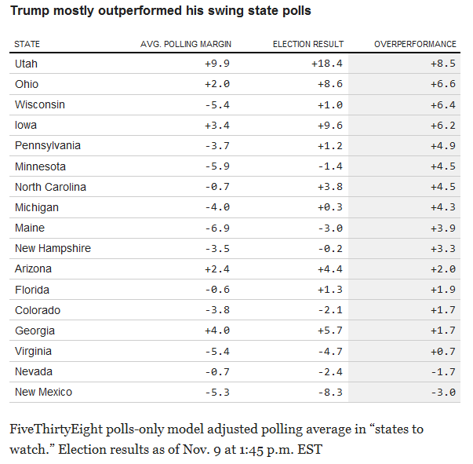
The 2016 Presidential Election Polling Errors in the Battleground States (11/8/2016)
According to fivethirtyeight.com, the polling error in states that Trump won was 7.4%. In states that Clinton won, the polling error was 3.7%
In the “rust belt” states, mostly won by Trump on Election Day (2016), the polling error was 4%
It is not unusual for the final polls in a presidential election to be off, but what is unusual about 2016 is that the polls predicted the wrong candidate as the winner
Notes:
Source: http://fivethirtyeight.com/features/the-polls-missed-trump-we-asked-pollsters-why/
In the average state won by Trump, the polls missed by an average of 7.4 percentage points (in either direction); in Clinton states, they missed by an average of 3.7 points. It’s typical for polls to miss in states that aren’t close, though. The most important concentration of polling errors was regional: Polls understated Trump’s margin by 4 points or more in a group of Midwestern states that he was expected to mostly lose but mostly won: Iowa, Ohio, Pennsylvania, Michigan, Wisconsin and Minnesota.
A “+” in the “overperformance” column indicate how much better Trump performed, as a %, relative to the final fivethirtyeight.com poll
Here are the “rust belt” states referred to on the slide: Iowa, Ohio, Pennsylvania, Michigan, Wisconsin and Minnesota

Slide 27
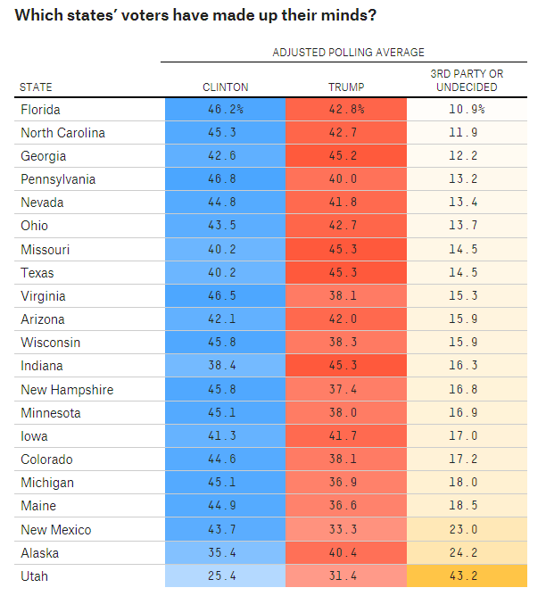
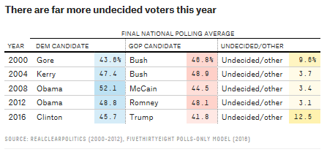
The 2016 Presidential Election Why so much uncertainty in modeling the election outcome?
In 2012, FiveThirtyEight.com estimated that Barack Obama had a 90% chance of winning the election
In 2016, Hillary Clinton’s chances were substantial, around 70% one day prior to the election, but far more uncertain than in 2012
The reason for the uncertainty was a higher % of undecideds and 3rd Party supporters in 2016, when compared to the undecideds and 3rd party supporters in past election cycles
Notes:
Source: fivethirtyeight.com – published Oct 25 2016 -- http://fivethirtyeight.com/features/election-update-where-are-the-undecided-voters/ What’s amazing about the undecideds and third party supporters is that Evan McMullin, a conservative Mormon from Utah, could possibly win Utah, actually winning 6 electoral votes. Nate Silver claims that 3rd party supporters typically have weak ties and are easily persuaded to vote for one of the major party candidates, which is why 538.com (Nate Silver) includes 3rd party supporters in “undecideds.”
Source: fivethirtyeight.com -- “Final Election Update: There’s a Wide Range of Outcomes, and Most of them Come up Clinton” http://fivethirtyeight.com/features/final-election-update-theres-a-wide-range-of-outcomes-and-most-of-them-come-up-clinton/ -- the historical chart comparing past election cycles to 2016

Slide 28
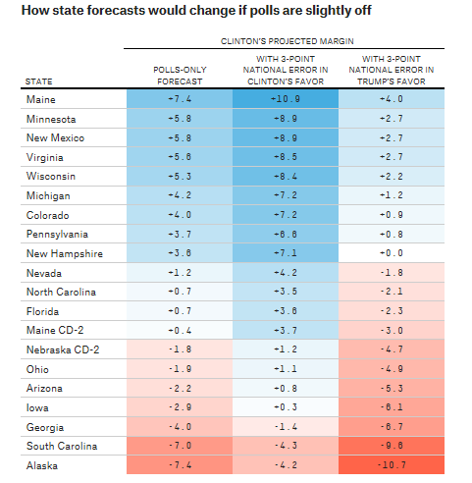
The 2016 Presidential Election Uncertainty in Presidential Polling: Adding Margins of Error
According to fivethirtyeight.com, we should add a margin of error to the final polling data in order to get a more realistic expectation of the outcome in a presidential election
It is not unusual for the final polls to be off by 3% or more, as they were in 1996, 2000 and 2016
In 1980, the final polls were off by an average of 7%
Notes:
Source: fivethirtyeight.com -- “Final Election Update: There’s a Wide Range of Outcomes, and Most of them Come up Clinton” http://fivethirtyeight.com/features/final-election-update-theres-a-wide-range-of-outcomes-and-most-of-them-come-up-clinton/
Here’s an excerpt:
Polls are good — but not perfect
The track record of polling in American presidential elections is pretty good but a long way from perfect, and errors in the range of 3 percentage points have been somewhat common in the historical record. Of note, for instance, is that Obama beat his national polling average by nearly 3 points in 2012, although state polls did a better job of pegging his position. In 2000, Al Gore was behind by about 3 points in the final national polling average but won the popular vote. In 1996, Bill Clinton was ahead in national polls by about 12 points, but won by 8.5.
In three of the last five presidential elections, in other words, there was a polling error the size of which would approximately wipe out Clinton’s popular vote lead — or alternatively, if the error were in her favor, turn a solid victory into a near-landslide margin of 6 to 8 percentage points. There’s also some chance of a larger error still. In 1980, Ronald Reagan led in final national polls by slightly less than Clinton does now, but wound up winning the popular vote by almost 10 percentage points.
Three- or 4-point polling errors should also be familiar from other contexts. Republicans beat their polls by 3 or 4 percentage points, on average, in competitive Senate and gubernatorial races in the 2014 midterms. Brexit was about a 4-point polling error, and the error in the 2015 U.K. general election was larger — Conservatives’ margin over Labour was understated by about 6 percentage points. We often get annoyed when people express shock after outcomes like these occur — polling is a tricky business — only to expect polls to be infallible the next time around.

Slide 29
Campaign Fund-Raising

Slide 30
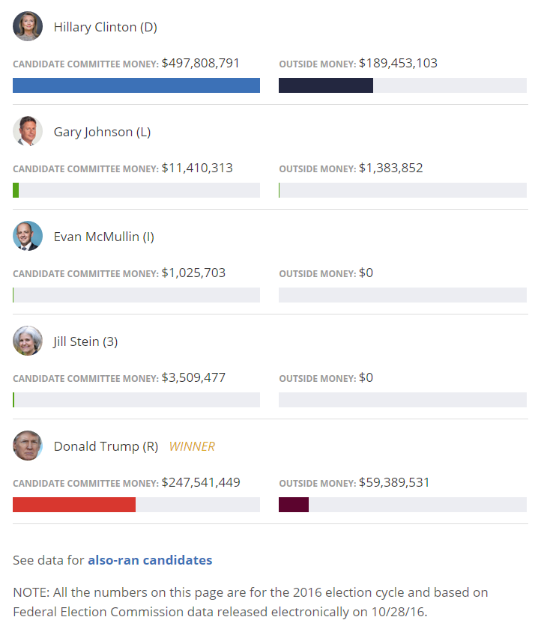
The 2016 Presidential Election Fund-Raising (Oct 28 2016)
With 10 days left in the campaign, Hillary Clinton had doubled Donald Trump in campaign donations, roughly $500 million to $250 million
And outside groups supporting Hillary Clinton had raised 3 times more money than outside groups siding with Donald Trump
Notes:
Source: https://www.opensecrets.org/pres16/ as of 10/28/2016

Slide 31
Campaign Controversies
Issues
That May Have Potentially
Affected the Election

Slide 32
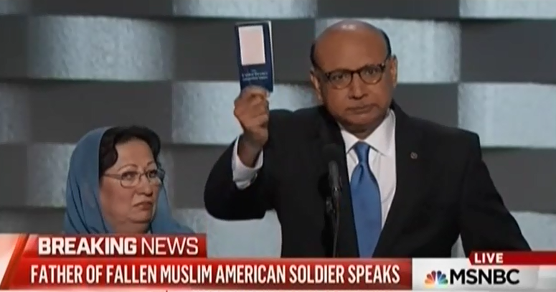
Trump’s Controversial Rhetoric
Commentary regarding Muslims
At the Democratic National Convention (July 28, 2016), Khizr Khan, a “gold star” father of a Muslim-American soldier killed in Iraq 12 years ago, criticized Trump for his plan to ban Muslim immigration from Syria and elsewhere where ISIS is active
Trump responded by asking why Mr. Khan’s wife was so silent standing next to her husband’s side, implying that Muslim women are treated badly in Islamic culture, even here in America
Dozens of Republican leaders criticized Trump for striking back against a “gold star” father, who had lost a son in war—critics included congressional leaders, Paul Ryan (R-WI) and Mitch McConnell (R-KY)
Khizr Khan (July-August 2016)
How will Trump’s “Muslim ban” be judged by the voters on Election Day? Hillary Clinton hopes that Trump’s rhetoric will be viewed as racist toward Muslims, resulting in a voter backlash against Trump
Notes:
What is a “gold star” family? It is a family that has lost a son or daughter in Iraq or Afghanistan, fighting Al Qaeda and ISIS. Politically, these families are honored by our political leaders, who know that attacking a “gold star” family could be perceived as an unfair attack on a family that has made the “ultimate sacrifice” for our country, i.e., sacrificing the life of their son or daughter fighting for our freedoms.
Donald Trump, being a political novice, is not so aware of the “cultural norms” constraining what politicians can do and cannot do or say or cannot say. Trump was attacked by Mr. Khan at the Democratic National Convention (July 2016), and felt that he has a right to defend himself, trying to turn the context of the debate around on Muslims, suggesting that women are treated so badly in Muslim culture.

Slide 33
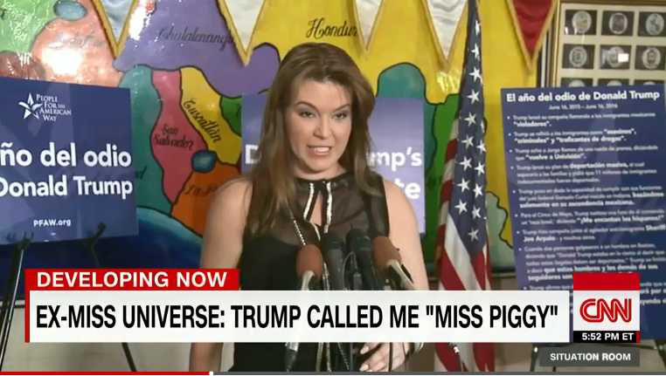
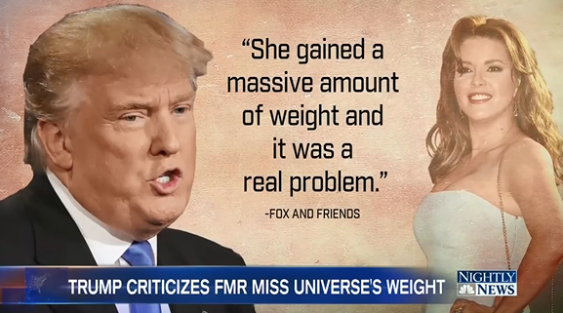
Trump’s Controversial Rhetoric
Comments about Body Shaming Women
Alicia Machado Controversy
In the 1st presidential debate (9/26/2016), Hillary Clinton brought out Donald Trump’s comments about the 1996 Miss Universe pageant winner, Alicia Machado. At that time, Trump called Miss Machado “Miss Piggy,” “Miss Housekeeping,” “Miss Eating Machine.”
In the days that followed, Trump engaged the debate, defending his comments from 20 years earlier, back when he ran the Miss Universe Pageant.
Hillary Clinton hoped that Trump’s “misogany” (disrespecting women) and “body shaming” comments about women would turn off women generally, and result in a lopsided vote by women for Hillary on Election Day

Slide 34


Trump’s Controversial Rhetoric
Vulgar Comments about the Female Anatomy
Access Hollywood Tape (2005)
Just 2 days prior to the 2nd presidential debate (Oct. 7 2016), the Washington Post released a 2005 audio/video tape, on which Donald Trump bragged about how his celebrity status enables him to make sexual advances on women…and get away with it.
Trump’s harshest critics described his comments on the audio as an admission of “sexual assault,” a serious crime
Again, dozens of Republican leaders condemned Trump’s comments, some calling for Trump to withdraw from the campaign
In the days that followed, 12 women eventually went public with accusations that Donald Trump had made inappropriate sexual advances against them
Notes:
Source: http://money.cnn.com/2016/10/07/media/access-hollywood-donald-trump-tape/index.html – Here is an audio tape of Trump’s 2005 comments about women, in which he bragged about being able to make moves on women and get away with it. He used some harsh language in the audio tape, referencing the female sex organ as the “p-word.”
For a day or two, it appeared that Trump’s campaign might be over. Dozens of Republican leaders condemned Trump’s statements, some of whom announced that they could no longer vote for him. Still other Republicans wanted Trump to withdraw from the race, most notably Mike Lee (R-UT), who was interviewed on Meet the Press (10/9/2016), calling for Donald Trump to withdraw so that Republicans would have enough time to choose another candidate, less than one month before the election. Later that night (10/9/2016), Trump performed well enough in the 2nd debate to save his campaign. Following the debate, Republicans no longer called for Trump to withdraw.
Between Oct. 7th 2016, the day that the Access Hollywood tape was released, and Oct. 28th 2016, the day FBI Director, Jim Comey, reopened his investigation of Hillary Clinton’s use of a private server while she was Secretary of State, Hillary’s lead in the RCP 4-way poll increased from 0.7% to 7.0%.
Source: http://nymag.com/thecut/2016/10/all-the-women-accusing-trump-of-rape-sexual-assault.html – a listing and summary of the women who have come forward to report cases of unwanted sexual advances by Trump
Source: http://www.usatoday.com/story/news/politics/onpolitics/2016/10/08/donald-trump-debate-mike-crapo-mike-lee-barbara-comstock/91784714/ -- a list of Republicans who said they could no longer vote for Trump
Source: http://www.nbcnews.com/meet-the-press/meet-press-october-9-2016-n662746 -- Here is a transcript of Meet the Press just 2 days after the Access Hollywood scandal broke
Here are some excerpts from the moderator’s, Chuck Todd, commentary: “Republicans are abandoning Trump, calling on him to step down. Can he survive this and what does survival even look like?” “Good Sunday morning, this one does feel different. There have been so many times we've said Trump can't survive this or can't survive that crisis. But the 2005 hot mic recording of Trump's conversation with Billy Bush of Access Hollywood may well prove to be the type of October survive-- surprise-- that even Donald Trump can't survive.” “Let's understand something. Trump is already likely to lose. The question now is how much damage will this do to the Republican Party? Already a parade of Republicans has either condemned Trump's comments, withdrawn their support completely or called on him to step down as the nominee altogether. Some are worried about their own prospects this fall, others are simply disgusted with Trump's words. Even the makers of Tic Tac Candies, which Trump referenced in that tape, said they found his comments and behavior to be unacceptable.”
“The 2005 conversation with Billy Bush, then host of Access Hollywood, has sent the Republican Party reeling. RNC Chair, Reince Priebus: "No woman should ever be described in these terms or talked about in this manner ever." House Speaker Paul Ryan disinvited Trump to a Saturday event, calling the comments ‘sickening.’” “Senate Republican leader, Mitch McConnell, called on Trump to, quote, "Apologize directly to women and girls everywhere." And Republicans in competitive elections rushed to condemn the comments, calling them offensive, inappropriate, outrageous, demeaning, disgraceful, indefensible and impossible to justify.”

Slide 35
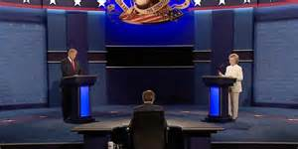
Would Trump Accept Election Results?
Transfer of Power: A Pillar of American Democracy
3rd Presidential Debate
In the 3rd Presidential Debate on Oct. 19, 2016, 3 weeks before Election Day (2016), Trump was asked if he would accept the election results, if he lost. His response, “I’ll tell you at the time…I will keep you in suspense.”
Being behind in the polls, Trump had been campaigning that the election was “rigged,” that the pollsters and media were against him, trying to boost Hillary’s chances of victory
Hillary used the opportunity to allege that Trump really didn’t support democracy, given that elections are a fundamental pillar of a democracy
Hillary hoped to win votes by labeling Trump a dictator at heart, one who was admiring of Vladmir Putin (Russia)
Trump refused to say he would accept the results of the election in the 3rd Presidential Debate. Hillary Clinton attacked Trump for being too authoritarian, for being against a fundamental pillar of democracy (elections)
Notes:
In the days following the debate, Republican supporters, including his Vice Presidential running mate, Mike Pence, tried to clarify Trump’s statement, insisting that what Trump meant was that he would not surrender his right to challenge the election results if there was widespread voter fraud. Pence was emphatic that Trump would accept the results of a free and fair election outcome.
Upon reflecting on his question to Trump, Chris Wallace, the debate moderator, said that he should have also asked Hillary Clinton the same question, because she could have lost the election too. But at the time, Hillary was way up in the polls (with a 7% lead in the Real Clear Politics 4-way average), and like most of us, Wallace probably assumed Hillary would win the election or that her answer would be in the affirmative, had he asked her if she would accept the election results.

Slide 36
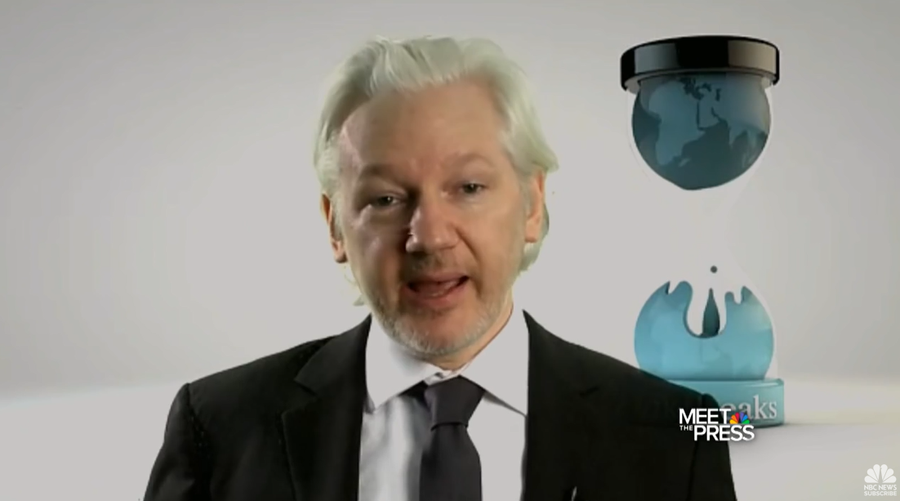
DNC & Clinton Foundation Corruption
Hacked Emails from DNC and Clinton Campaign
WikiLeaks Targeting Clinton
In August (2016), Wikileaks released hacked emails from the Democratic National Committee (DNC) revealing collusion between the DNC and Hillary Clinton campaign against Bernie Sanders during the Democratic primaries
In October (2016), Wikileaks released hacked emails from John Podesta, Hillary Clinton’s campaign chairman, revealing that Hillary had solicited a $12 million donation from the King of Morocco in exchange for her making a keynote address at a Clinton Foundation event in Morocco
Also, in October (2016), Wikileaks released an internal memo at The Clinton Foundation, revealing that Bill Clinton had personally profited from money and favors paid to him for speeches and access, in his official capacity at the Clinton Foundation, which if true, would be a violation of U.S. charity laws
WikiLeaks Founder, Julian Assange, dropped a number of bombshells throughout the 2016 presidential campaign, revealing DNC internal emails, Clinton campaign internal emails, as well as memos internal to The Clinton Foundation
Notes:
Source: http://www.cnn.com/2016/10/26/politics/wikileaks-john-podesta-teneo-clinton-foundation/index.html
Here are some excerpts from the CNN summary:
“The 2011 memo, marked "Attorney-Client Privilege" was sent by Doug Band to two attorneys…Band details how he set up for-profit deals for the former president, both involving money and ‘as appropriate, in-kind services for the President and his family -- for personal travel, hospitality, vacation and the like.’“ “Band's memo covers 2001 to 2011, during which time "President Clinton's business arrangements have yielded more than $30 million for him personally with $66 million to be paid out over the next nine years, should he choose to continue with the current engagements.“
The Wikileaks revelations are very interesting and disturbing. They provide great insight into the DNC, Clinton campaign, and The Clinton Foundation, but they are also disturbing because the emails were stolen, and emails are private property. Even more disturbing is that U.S. intelligence agencies believe that the Russian government is behind hacks. If so, a foreign power has intervened in a U.S. election, clearly against Hillary Clinton.
These leaks may have helped Trump win the election, and I’m sure they have helped Republicans make a case of corrupt practices against Hillary Clinton and the Democratic National Party, but if this theft (hack) goes unpunished, then the Russians could turn on the Republicans and private corporations (similar to the North Korean hack of Sony Pictures). The bottom line is that this is an attack on private property, one of the pillars of a free society, and no one but the Clinton campaign seems to care—and sadly, the Clinton campaign likely only cares because it hurt its efforts in helping Hillary get elected, not because this is an attack on a fundamental pillar of a free society.

Slide 37
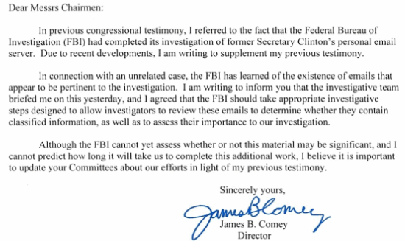
Hillary Clinton’s Private Email Server
Last-Minute Surprise: 2nd FBI Investigation
The FBI investigated Hillary Clinton’s use of a private email server while she was Secretary of State (2009-13) for mishandling and potential violations of the law regarding classified (secret) material
On July 5, 2016, prior to the major party conventions, FBI Director, James Comey, exonerated Clinton of any potential crimes
On Oct. 28, 2016, just 11 days before Election Day (2016), FBI Director, James Comey, essentially reopened the investigation, after finding over 650,000 emails on a laptop seized during an unrelated investigation
On Nov. 6, 2016, James Comey exonerated Hillary Clinton for a second time, just 2 days prior to the election
Bombshell FBI Investigation
The FBI Director (Jim Comey) dropped a “bombshell” last-minute surprise just 11 days prior to the presidential election, focusing the news cycle on Hillary Clinton’s duplicitous nature, breathing new life into the Trump campaign
Notes:
Source: http://www.nytimes.com/interactive/2016/10/28/us/politics/fbi-letter.html?_r=0 – Here is Jim Comey’s letter, opening a 2nd investigation into Hillary Clinton’s use of a private email server while she was Secretary of State (2009-2013).
During the campaign, Donald Trump attacked Hillary Clinton relentlessly regarding her private email server, implying that she was guilty of crimes for mishandling and destroying evidence. In the 2nd presidential debate, he promised that if he were elected president, his Attorney General would prosecute Hillary, at one point, in response to Hillary’s warning about someone like Trump being in charge of the U.S. Justice System, saying you [Clinton] “would be in jail.” His TV ads highlighted Hillary’s destruction of personal devices (e.g., ~12 cell phones) and her subordinates use of “bleachbit” to acid wash her server, thus destroying some 33,000 emails, hoping that these emails would be irrecoverable, this occurring after Congress issued a subpoena for those emails.
In the Real Clear Politics 4-way average poll, Hillary Clinton’s lead dropped from between 5.4% to 5.8% down to 1.7% at its lowest during the 2nd FBI investigation, from Oct. 28th to Nov. 6th. Trump became more disciplined during this period, making fewer distracting comments, while Hillary Clinton was on the defense. The news cycle was very negative, focusing the public on Hillary Clinton’s flaws, the allegation that she is too corrupt and dishonest to be president.
There is speculation as to why Jim Comey dropped this bombshell just 11 days before the election, which is this. Many rank-and-file FBI agents disagreed with Comey’s decision to exonerate Hillary Clinton over the July 4th weekend (2016), and some FBI agents in the NYC office were leaking information to one of Donald Trump’s surrogates, Rudy Guiliani. The NYC FBI office was investigating an allegation that Anthony Weiner, former member of the U.S. House and husband of Huma Abedin, who is Hillary Clinton’s closest aide, had sent a sexually explicit picture to a 15 year old girl. They found 650,000 emails to and from Hillary Clinton on Weiner’s computer. The FBI director felt that he had to get out front of this story, before his agents leaked it to the press, so he preempted the leak by going public with the new investigation. Why he ended the investigation 2 days before the election, exonerating Hillary Clinton for a second time??? I’m just speculating here, but perhaps he was trying to strike a compromise, knowing that he had hurt Hillary’s chances of becoming president 9 days earlier, to remove the damaging allegation against Clinton in time for her to make a reasonable recovery and still pull out a victory in the election.
Hillary Clinton’s poll numbers, in the RCP 4-way average, actually started to increase one day before the FBI director exonerated Hillary for a 2nd time. But after the director’s exoneration, her poll numbers continued to increase, up to a lead of 3.3% in the final RCP poll.
Here are FBI Director Jim Comey’s comments exonerating Hillary Clinton for a 1st and 2nd time.
Conclusion of 1st FBI Investigation of Hillary Clinton’s Use of a Private Email Server: https://www.fbi.gov/news/pressrel/press-releases/statement-by-fbi-director-james-b-comey-on-the-investigation-of-secretary-hillary-clinton2019s-use-of-a-personal-e-mail-system
Here is an excerpt of Jim Comey’s exoneration of Hillary Clinton (July 5, 2016): “Although there is evidence of potential violations of the statutes regarding the handling of classified information, our judgment is that no reasonable prosecutor would bring such a case. Prosecutors necessarily weigh a number of factors before bringing charges. There are obvious considerations, like the strength of the evidence, especially regarding intent. Responsible decisions also consider the context of a person’s actions, and how similar situations have been handled in the past.”
Conclusion of 2nd FBI Investigation of Hillary Clinton’s Use of a Private Email Server: Here is Comey’s conclusion, 2 days before the presidential election. November 6, 2016
Dear Messrs. Chairmen:
I write to supplement my October 28, 2016 letter that notified you the FBI would be taking additional investigative steps with respect to former Secretary of State Clinton's use of a personal email server. Since my letter, the FBI investigative team has been working around the clock to process and review a large volume of emails from a device obtained in connection with an unrelated criminal investigation. During that process, we reviewed all of the communications that were to or from Hillary Clinton while she was Secretary of State.

